Slide 1
Two-Wheeler Marketplace Web App
Problem Statement ID: HACXPB003
Company: Vahan Bazar

Slide 2
Problem Statement & Summary
Build a two-wheeler marketplace web app where users can:
• Browse bikes, scooters, and EVs
• Search & filter by brand, price, fuel type
• View detailed specs & compare models
• Use EMI & fuel cost calculators
• Explore showrooms & book test rides
• Sell used bikes

Slide 3
Suggested Tech Stack
Frontend:
React / VUE / Angular
Backend:
Node.js / Flask / Django
Database:
PostgreSQL / MongoDB / SQLite

Slide 4
About Company
Company: Vahan Bazar
Industry: Online Vehicle Selling Platform for Dealerships
About: Buy and Sell Bikes in Seconds.
• Ultimate bike inventory management
• Supports multi-shop vehicle dealerships
• Track sales, manage inventory, and grow business effortlessly

Slide 5
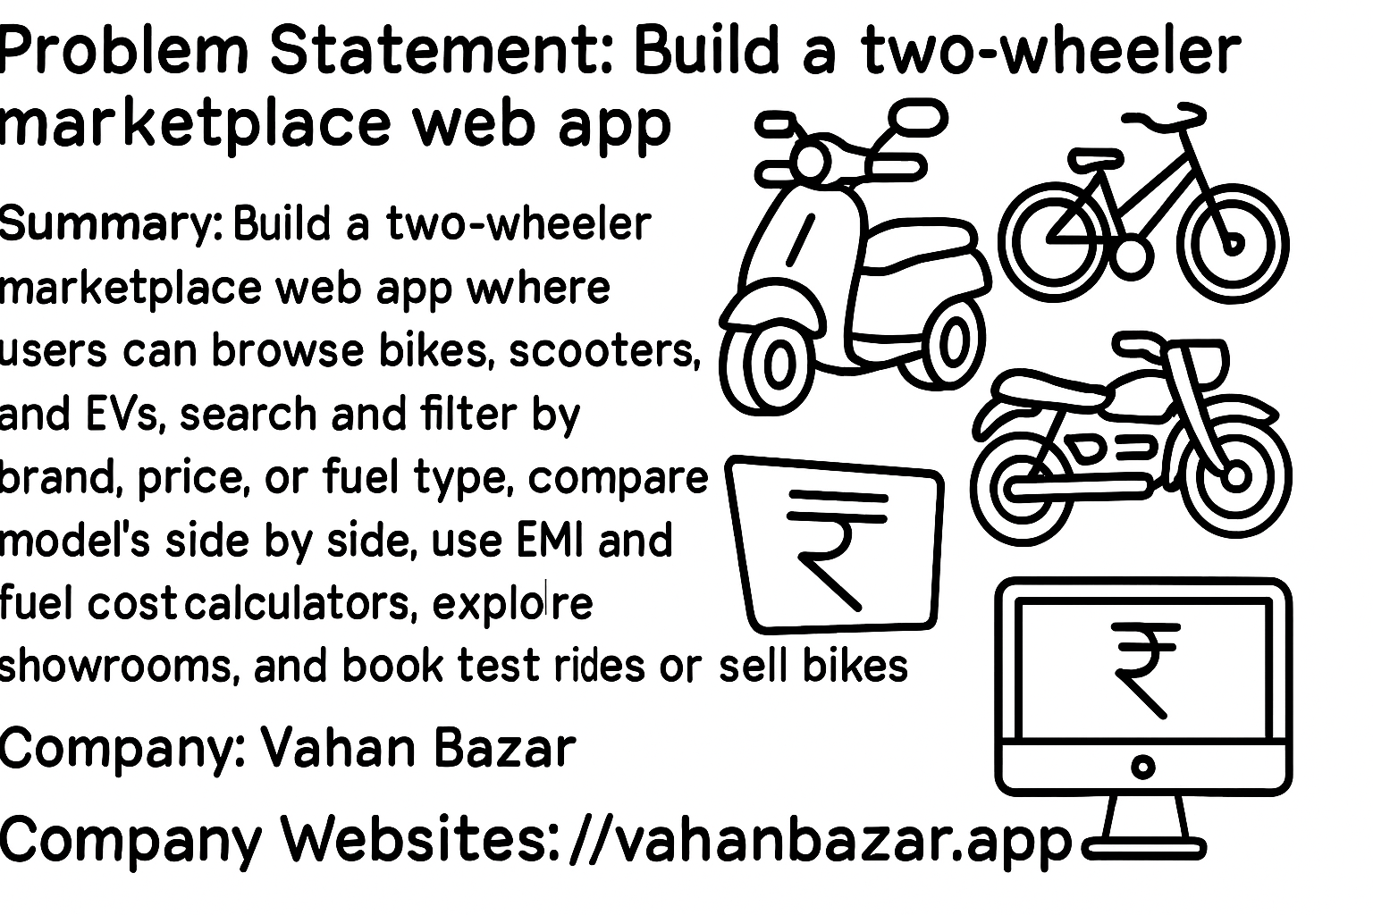
Visit us at: https://vahanbazar.app/

Slide 6
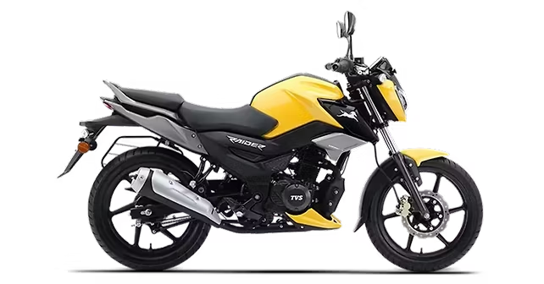
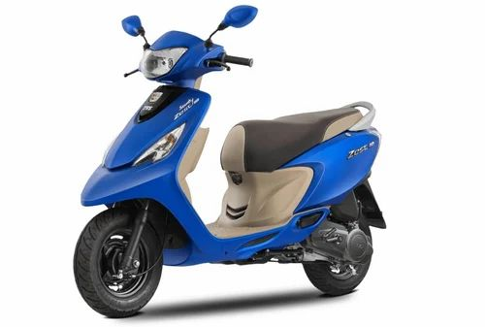
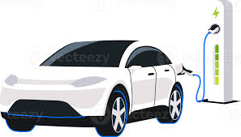


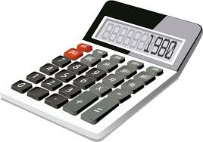
Key Features of Vahan Bazar
• Browse & Filter Bikes, Scooters, EVs
• Detailed Vehicle Specs & Model Comparison
• EMI and Fuel Cost Calculators
• Book Test Rides Online
• Sell Used Bikes with Ease
• Dealer Inventory Management System
EV Pic

Slide 7
About Two-Wheelers
A two-wheeler is a vehicle with two wheels, widely used for personal transport. They can be powered either by human effort (like bicycles) or by engines/motors (like scooters, motorcycles, and electric bikes).
Types:
• Bicycles – pedal-powered, eco-friendly
• Scooters – lightweight, city-friendly
• Motorcycles – powerful, long-distance capable
• Electric Two-Wheelers – battery-powered, pollution-free
Advantages:
• Affordable & economical
• Easy navigation in traffic
• Low maintenance & fuel cost
• Ideal for short and medium travel

Slide 8



